Slide 1



Prepared with the Contribution of
TO STUDY AND VERIFY
SUPERPOSITION THEOREM AND MAXIMUM POWER TRANSFER THEOREM
To Study and Verify the Superposition Theorem and Maximum Power Transfer Theorem
3DEXPERIENCE R2021x

Slide 2



Prayag Sridhar Electrical and Electronics Engineering Third year prayag.ee18@bmsce.ac.in
BMS College of Engineering
TO STUDY AND VERIFY
SUPERPOSITION THEOREM AND MAXIMUM POWER TRANSFER THEOREM
Student Bio:
B.M.S. College of Engineering (BMSCE) is an autonomous engineering college in Basavangudi, Bangalore, India. It was started in 1946 by Bhusanayana Mukundadas Sreenivasaiah and is run by the B.M.S. Educational Trust. It is affiliated with Visvesvaraya Technological University and became autonomous in 2008. BMSCE is located on Bull Temple Road, Basavanagudi, diagonally opposite to the famous Bull Temple.
Teacher Bio:

Slide 3
SUPERPOSITION THEOREM
In a circuit containing linear multiple independent sources, The current or voltage in the network is calculated as algebraic sum of individual contributions of each source acting alone.
MAXIMUM POWER TRANSFER THEOREM
Maximum Power delivered by a source is represented by its Thevenin’s equivalent circuit is attained when Load resistance is equal to the Thevenin’s Resistance.

Slide 4
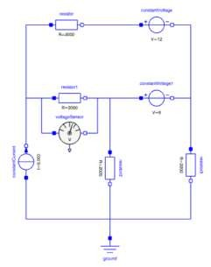
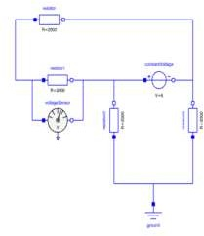
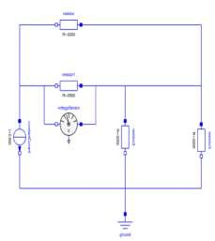
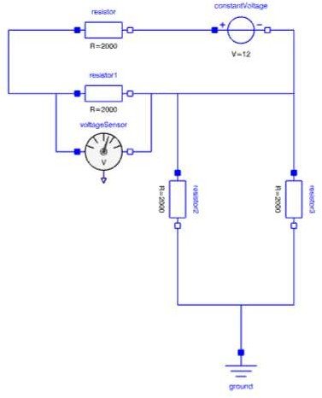
VERIFICATION OF SUPERPOSITION THEOREM
=
+
+
Circuit 1 Circuit 3
Circuit 2
Main Circuit
There are three independent sources in the main circuit, In circuit 1,2,3 there is only one independent sources( Current or voltage source) in each circuit and the other two are removed. The end result is ‘Voltage across resistor_1 in main circuit’ is equal to sum of ‘Voltage across resistor_1 in 3 other circuits(Circuit_1,Circuit_2,Circuit_3)’.

Slide 5

SIMULATION IN 3D EXPERIENCE
1. Open CATIA Dymola Behavior Modeling Application

Slide 6
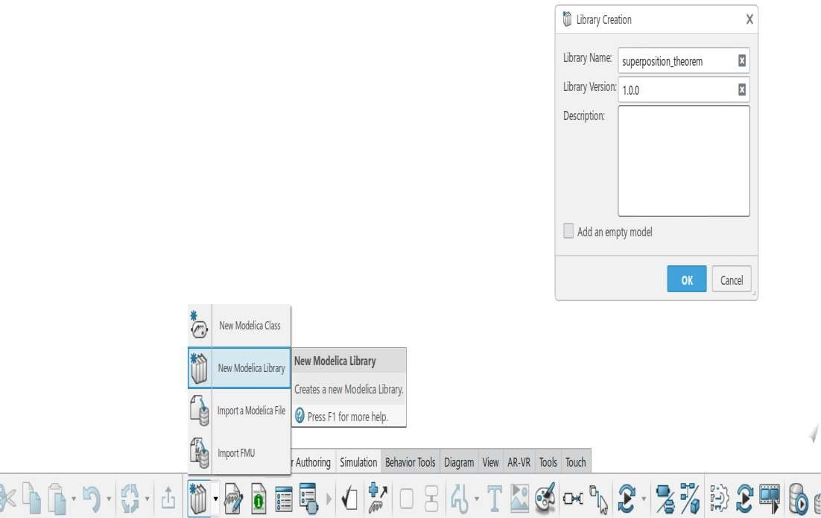
Click on Behavior Authoring and Select New Modelica Library
3. Create a new library and name it [superposition_theorem] and press OK button

Slide 7
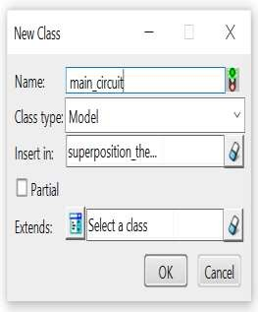
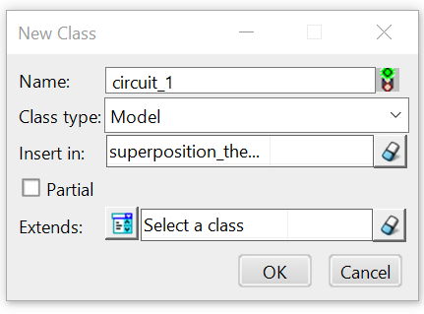
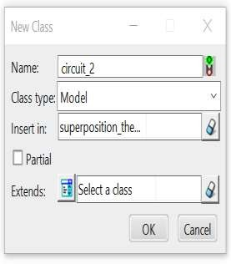
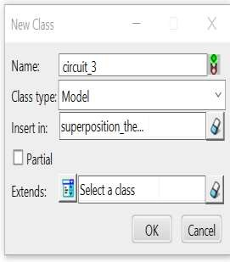
4. Create 4 new classes from Behavior Authoring Section and name it as [Main_circuit], [Circuit_1], [Circuit_2],
[Circuit_3] and on insert all the created classes in the already created library [superposition_theorem] and Press OK

Slide 8
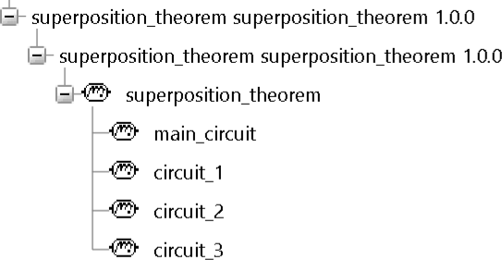
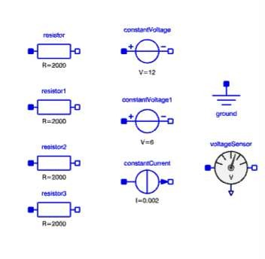
5. The following Library along with their classes will be
created in the Package Browser
Open the [main_circuit] class under the library [superposition_theorem]
Go to Modelica>Electrical>analog and drop 4 resistors(each of R=2000 ohm)
constant voltage sources - one of 12V(constantVoltage) and other is 6V(constantVoltage1) and constant current source of 0.002A and Ground and From Modelica>Electrical>Sensors Drop a Voltage sensor

Slide 9
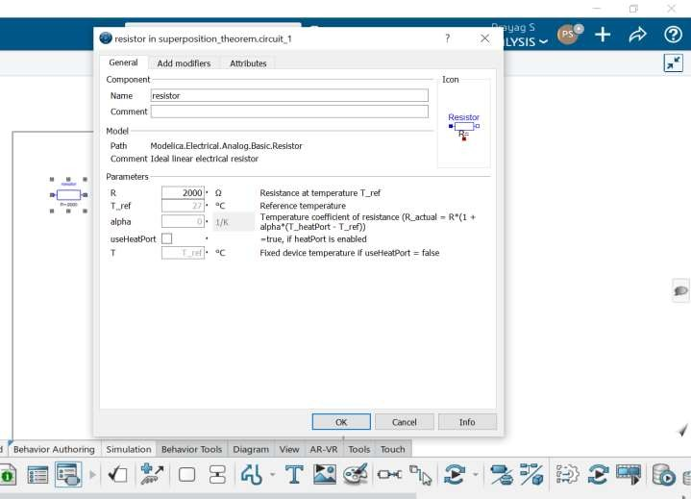
8. For changing the parameters left click twice on the resistor component

Slide 10

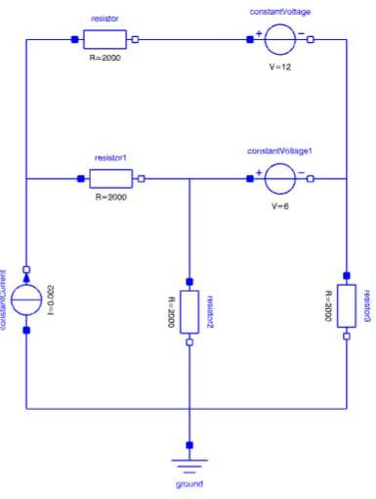
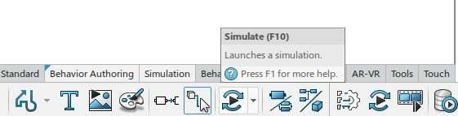

9. Connect all the components to the circuit shown below and press simulate option.

Slide 11
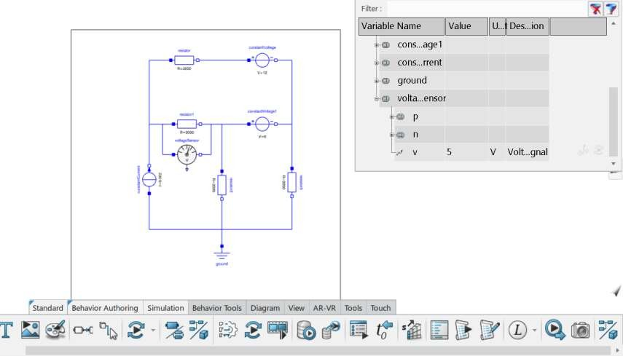








10. When it is in simulation, Scroll down and double click on voltage sensor button and you can see the value of voltage
which is 5V(voltage of resistor1 of [main_circuit] is 5V). This value has to be verified by using superposition theorem and will be displayed in further steps.
.

Slide 12
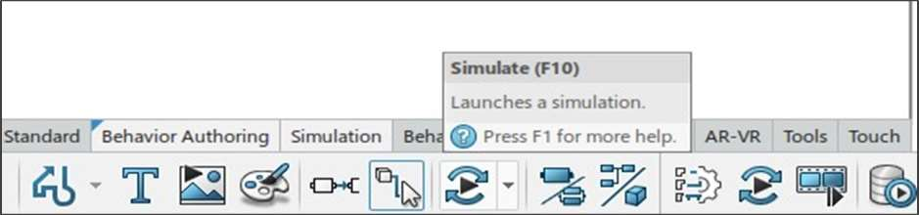
Now For Verification of Superposition Theorem, Go to Superposition_theorem>Circuit_1
12. In the next step from [Main_circuit], Constant Voltage source of 6V is removed and short circuited and constant current
source of 0.002A is removed and open circuited which results in circuit below and is named as [circuit_1] and is simulated.

Slide 13
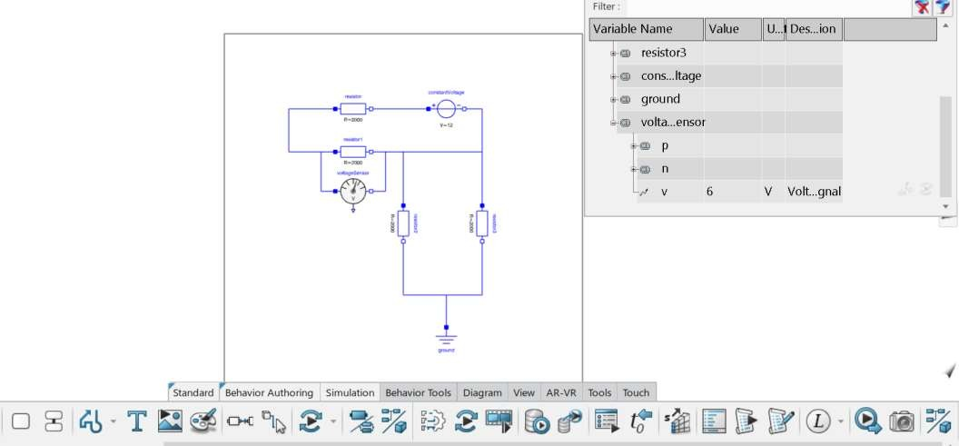

13. When it is in simulation, Scroll down and double click on voltage sensor blue button and you can see the value of voltage which is 6V (Voltage of Resistor_1 of circuit_1 = 6V)

Slide 14
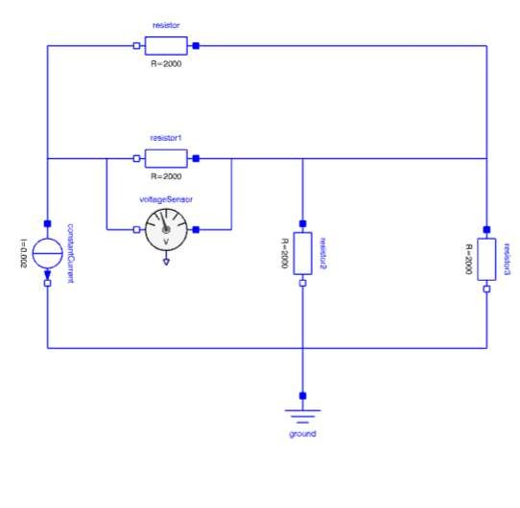
Go to class [Circuit_2] under [Superposition_theorem] library
From the circuit in [main_circuit] class, The constant voltages of 12V and 6V is removed and it is short circuited and only constant current source of 0.002A is present, which results in the circuit given below and is named [Circuit_2] and it is simulated.

Slide 15
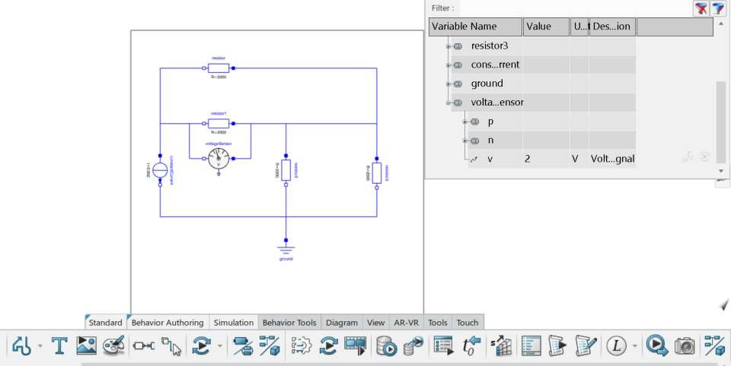

16. When Simulation is going on, Go to voltage sensor and click on the blue button and you can see the value of voltage
which is 2V (Voltage of Resistor_1 of circuit_2 = 2V)

Slide 16
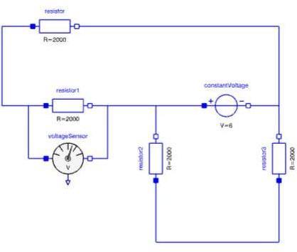
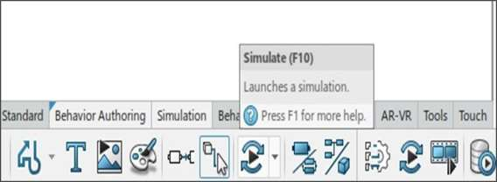
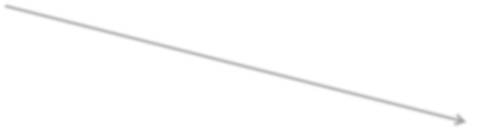
Go to class [Circuit_3] under [Superposition_theorem] library
18. From the circuit in [main_circuit] class, The constant voltages of 12V is removed and it is short-circuited and the constant current source of 0.002A is removed and is open circuited, Only one independent source(constant voltage of 6V) is present and is shown below. It is named as [circuit_3] and it is simulated.

Slide 17
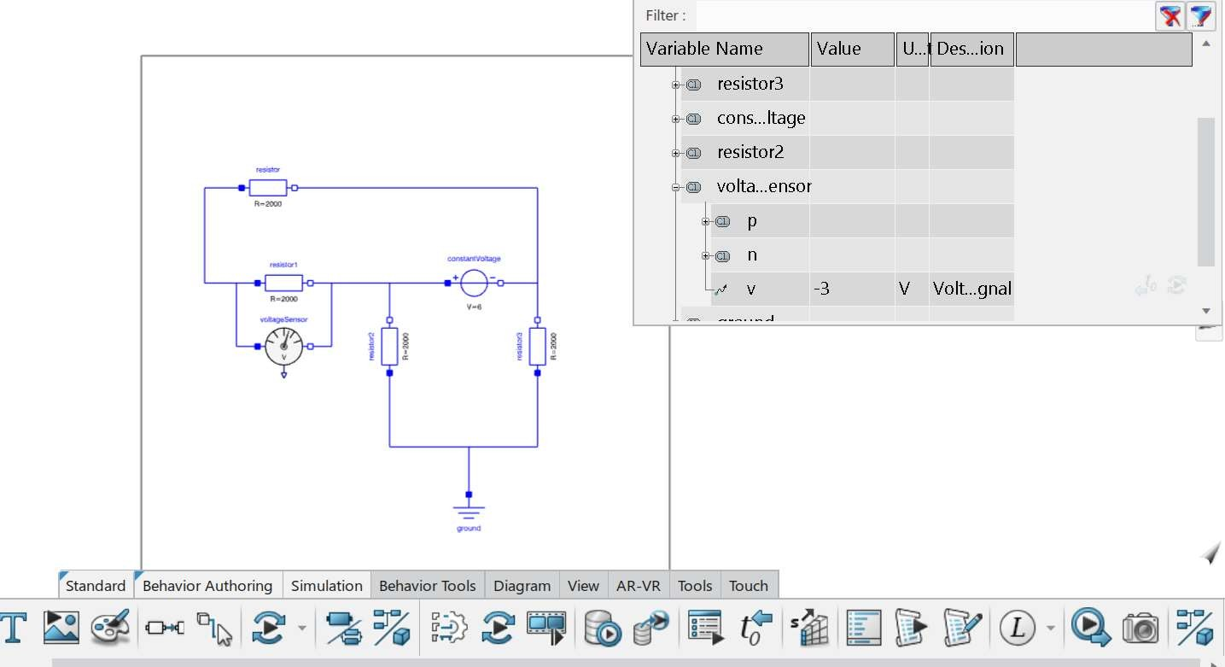

19. When Simulation is going on, Go to voltage sensor and click on the blue button and you can see the value of voltage which is -3V (Voltage of Resistor_1 of circuit_3 = -3V)

Slide 18
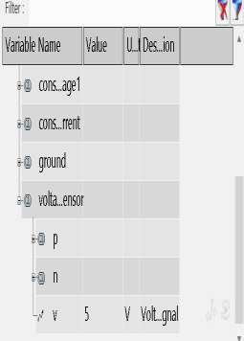
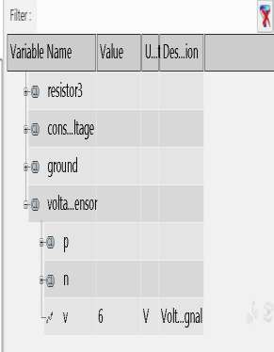
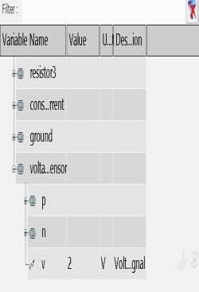
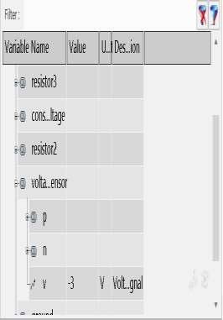

20. Voltage across Resistor1 in [main_circuit](5V) is equal to Sum of voltage obtained across [circuit_1],[circuit_2],[circuit_3]
(6V+2V-3V) . The simulated values is obtained and the Superposition theorem is verified
Main_circuit Circuit_1 Circuit_2 Circuit_3
=
+
+
Value of Voltage obtained in simulation of main_circuit.
Value of Voltage obtained in
simulation of circuit_1.
Value of Voltage obtained in simulation of circuit_2.
Value of Voltage obtained in simulation of circuit_3.

Slide 19
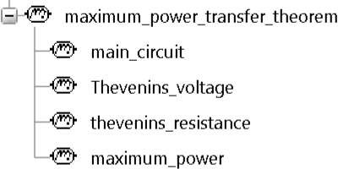
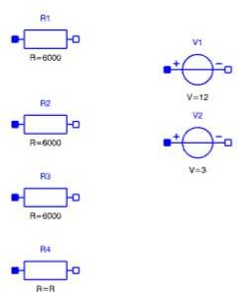
VERIFICATION OF MAXIMUM POWER TRANSFER THEOREM
Now, we are going to study and verify maximum power transfer theorem, Go to Behaviour Authoring and create a
library [maximum_power_transfer_theorem]
Under the created library [maximum_power_transfer_theorem], Create classes [main_circuit], [thevenins_voltage],
[thevenins_resistance], [maximum_power].
From Modelica>Electrical>Analog>Basic , Drop the components R1,R2,R3,R4 and constant voltages V1, V2 and place it in [main_circuit] ,the parameters of the individual components can be changed by double-clicking on it

Slide 20

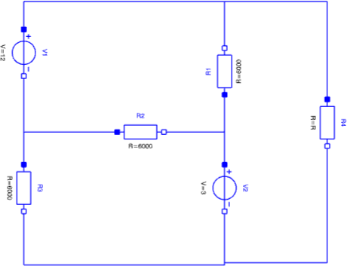
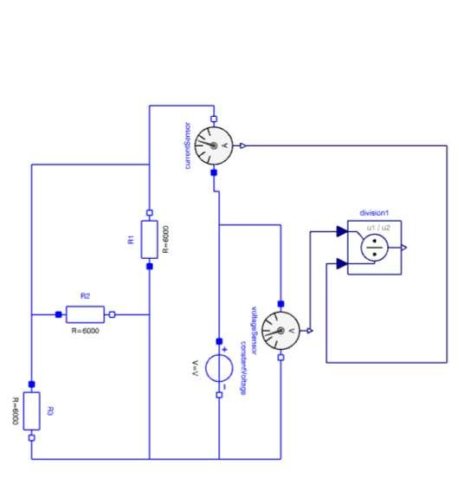

Go to [main_circuit] and connect the components as shown in figure below , By double clicking on individual components. the parameters is changed. R1,R2,R3 is set to 6000 ohm and R4 = R, Constant voltages is set to 12V and 3V.
Now, to find maximum power Transfer, thevenin’s voltage and thevenin’s resistance is to be found. For finding thevenin’s resistance from the [main_circuit] ,load resistance( R4) is removed and ammeter, voltmeter (which is found in modelica > electrical > analog > sensors) and divisor (which is found in modelica > blocks > math) is connected as shown in figure below along with constant voltage to find Thevenin’s Resistance.
.
.

Slide 21
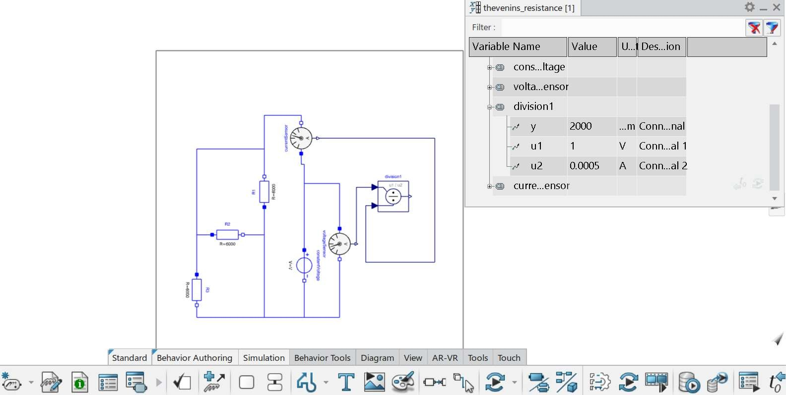




SIMULATIONIN 3D EXPERIENCE
Place the circuit obtained from Step 5 to class [thevenins_resistance]
In the simulation window, Go to division1 and press the ‘+’ button to view the value of equivalent resistance
which is 2000 ohm
.
.

Slide 22

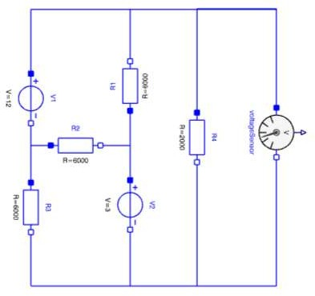
Now, according to maximum power transfer theorem, Maximum Power delivered by a source is represented by its Thevenin’s equivalent circuit is attained when Load resistance is equal to the Thevenin’s Resistance. Therefore, Load Resistance (R4) is also 2000 ohm.
Now, Load resistance (R4) is connected back to the main_circuit which is then put into different class [thevenins_voltage] and the voltage across R4 is to be calculated to find the Thevenin’s Voltage as shown in the
figure below.
10. Press simulate button to obtain the thevenin’s voltage .
.
.

Slide 23
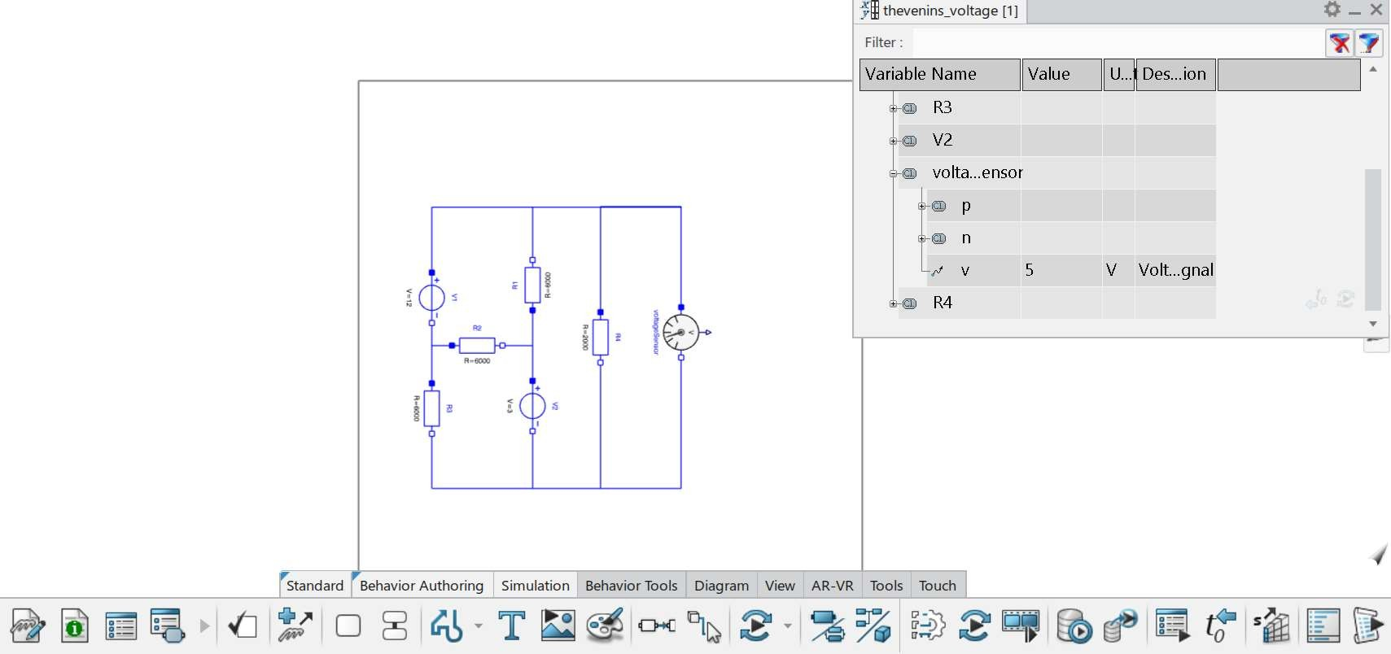

SIMULATIONIN 3D EXPERIENCE
11. In the simulation window, Go to voltage sensor and press the ‘+’ symbol to view the value of thevenin’s voltage which is 5V.
.
.

Slide 24
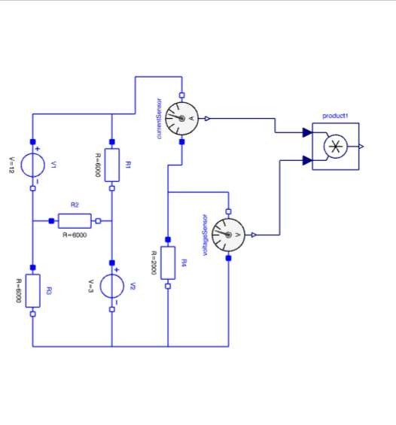
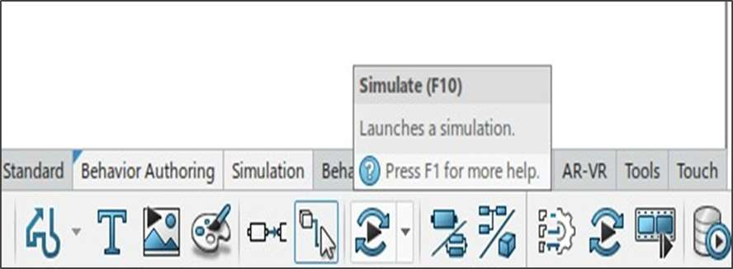
Now, Power is calculated using thevenin’s voltage (V) and thevenin’s resistance (R4) by using the formula P = (V^2 ) / R, P = ( 5 * 5 / 2000 ) = ( 25 / 2000 ) = 0.0125W or 12.5mW.
The above obtained ‘ P ‘ value is the maximum power, Now to verify it we are going to use the component ‘product’ (which is found in modelica > blocks > math) along with ammeter and voltmeter (which is found in modelica > electrical > analog > basic) and place the circuit in the separately created class [maximum_power].
14. Press simulate to get the value of maximum power.
.
.

Slide 25
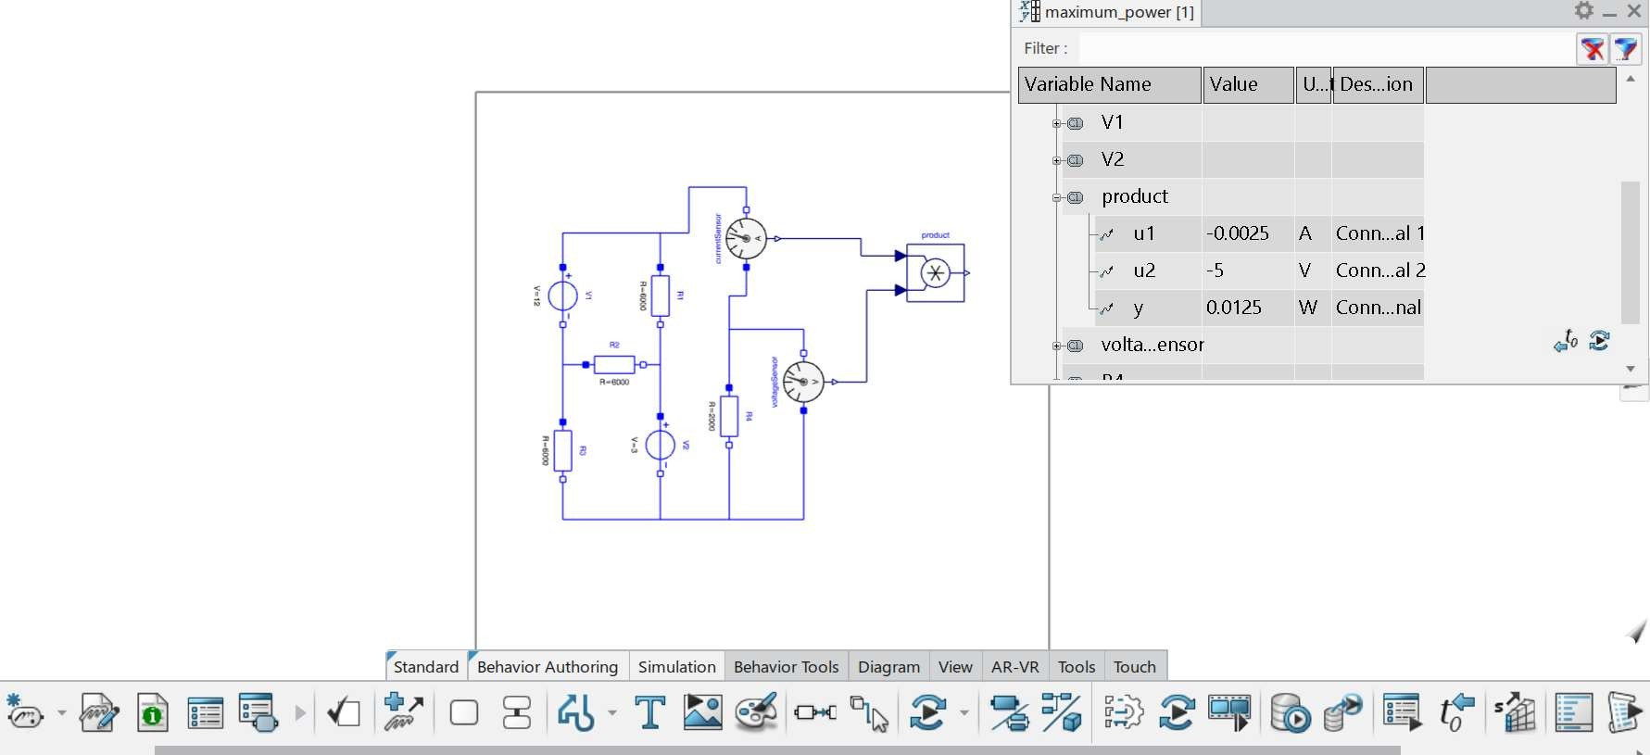

SIMULATIONIN 3D EXPERIENCE
15. In the simulation window, Go to product and press the ‘+’ symbol to view the value of maximum power which is 0.0125
Watt. Hence, Maximum power is obtained and verified.
.
.

Slide 26

References
NETWORK ANALYSIS BY K.CHANNA VENKATESH, D.GANESH RAO ( PAGE NO – 297 TO 299 & PAGE NO – 349 TO
352)
Stack overflow for superposition theorem
https://electronics.stackexchange.com/questions/71027/superposition-theorem
Stack overflow for maximum power transfer theorem https://electronics.stackexchange.com/questions/497307/regarding-maximum-power-transfer-theorem-and- how-is-it-difference-from-maximum-e

